Slide 1
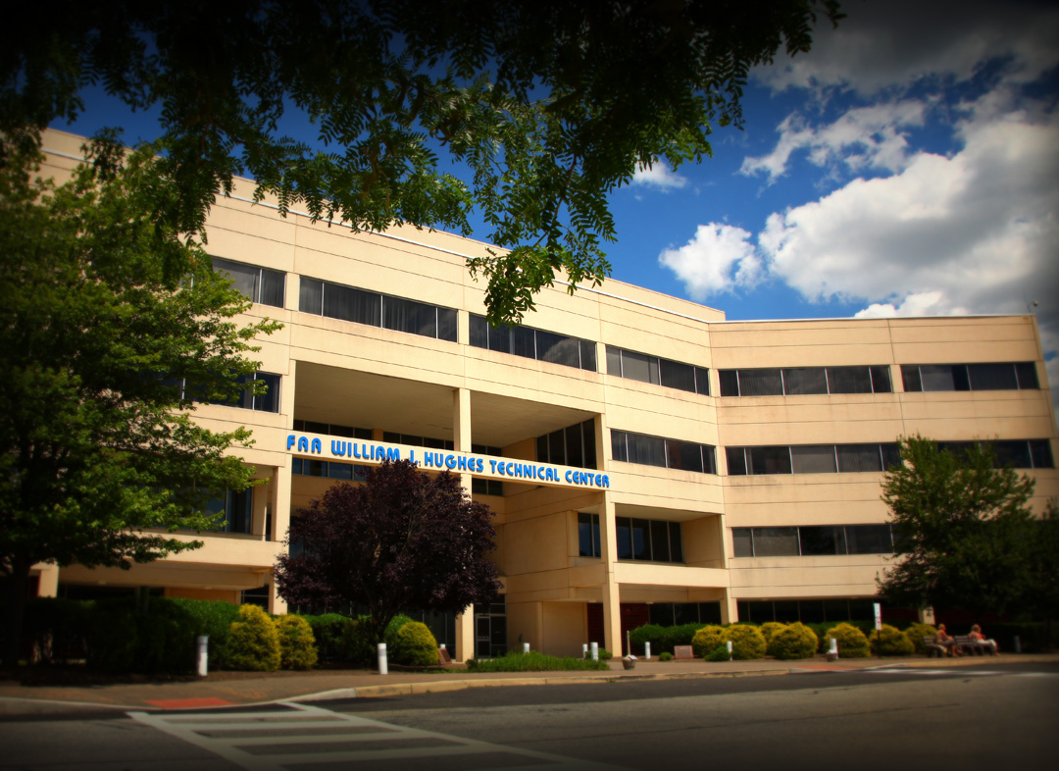
William J. Hughes Technical Center
Presented to:
By:
Date:

Slide 2
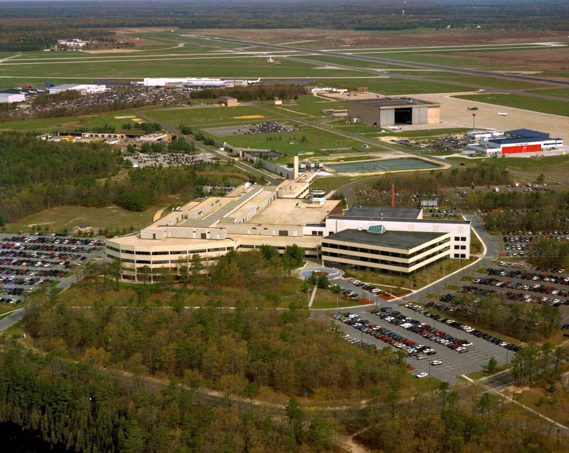
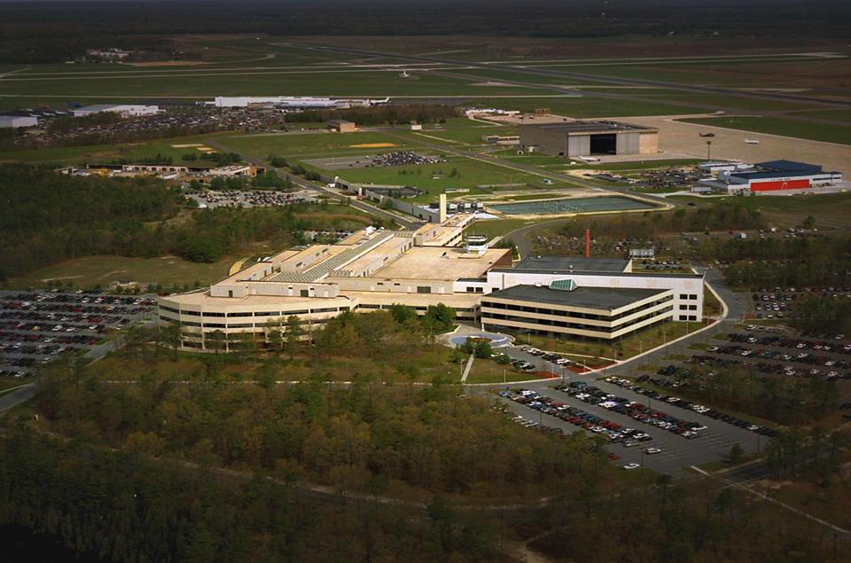

Slide 3
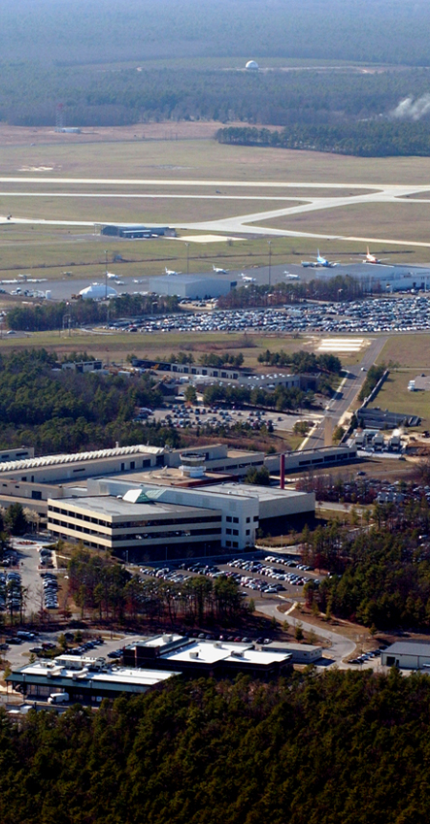
The FAA William J. Hughes Technical Center
Supports the advancement of the Next Generation Air Transportation System by
    Being the nation's leading federal laboratory for Research, Development, Test, and Evaluation
    Integrating systems and capabilities through collaboration with Industry, Academia, and Government
Provides the gateway for National Airspace System upgrades, improvements, and operational sustainment
Notes:
The Tech Center Director is also the Director of Research Development, Test and Evaluation for the FAA.
It includes the national laboratory for air transportation systems and the only national laboratory of its type in the U.S. and the world.
Responsibility for researching technologies and
The testing and evaluation of new technologies/systems
The Tech Center is part of the FAA’s NextGen organization, but it serves more than NextGen. There is an FAA responsibility that is outside ANG.
Also located at the TC are organizations responsible for new system development and maintenance of existing systems

Slide 4
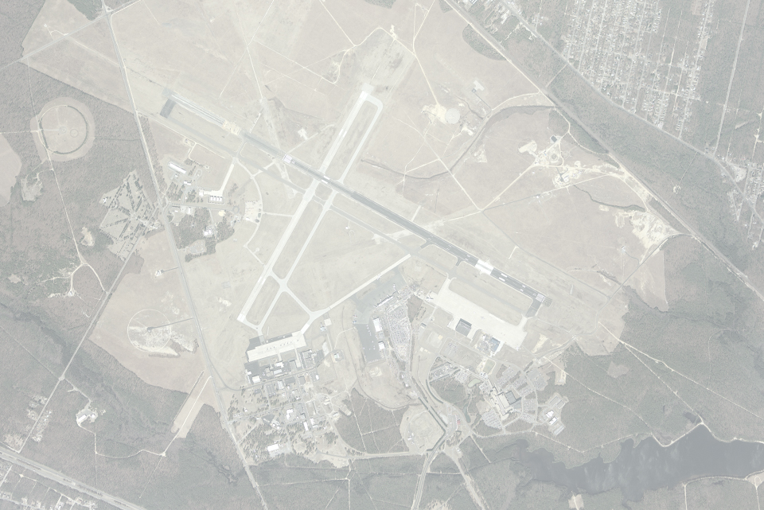
WJHTC Quick Facts
5,000 Acres
250+ Buildings
4,500 employees (3,000 FAA/Contractor)
400,000 sq. ft. laboratories
“NAS under one roof”
Notes:
5,000 acres and over 250 buildings. A lot of those buildings are very specialized. They range from small buildings to this technical and administrative complex Building 300/316
4,500 people, of that 1500 of those are FAA employees, 1500 or so are FAA contractors and the remainder is spread among our other tenants
Over 200,000 square feet of high quality automation laboratories with robust power and ventilation/air conditioning.
We have the national air space system under one roof, which means we have one of each communications, weather, and navigation, and automation gear in the system and most or at least a representative sample of the surveillance gear.
We do research, test and 24/7 engineering support.
We do have an operational tower, TRACON.
And we will talk more about the tenants later
250 – 350 million contract dollars come from TC work

Slide 5
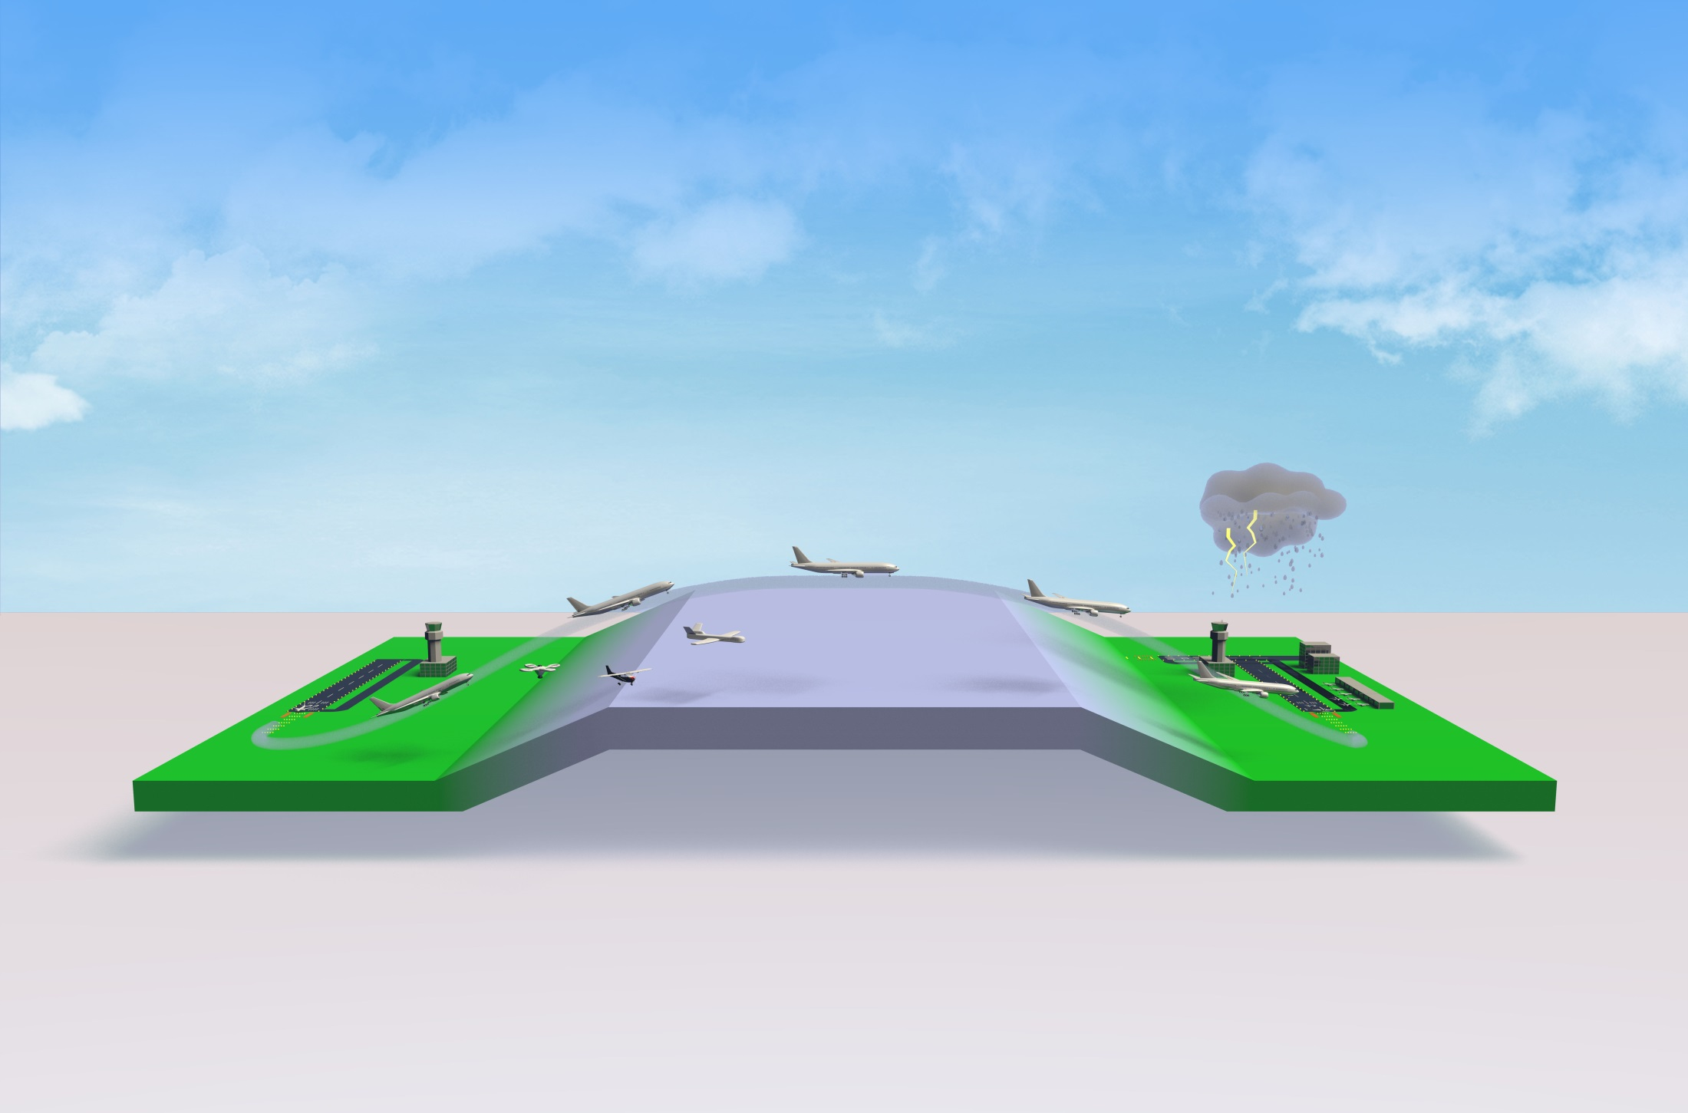
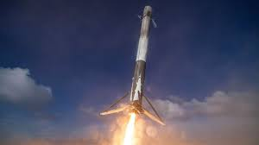














Research & Development
Commercial Space
Fire Safety
Propulsions
UAS
Aircraft
Structures
Airport and Terminal
Digital Systems
Weather
Pavement
Icing
Human Factors
Cyber Security
System Safety
Management
Environment
and Energy

Slide 6

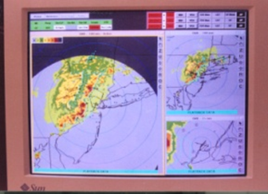
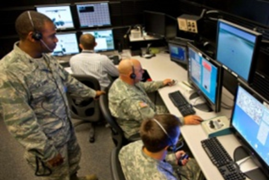
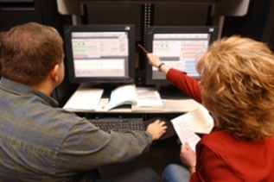
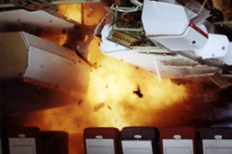
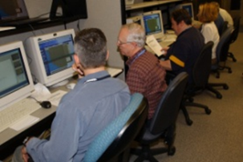
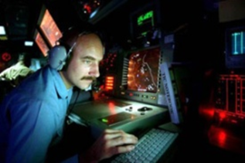
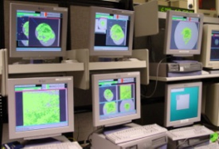
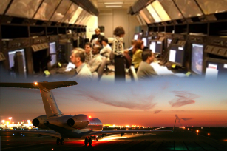
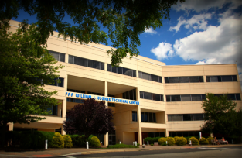
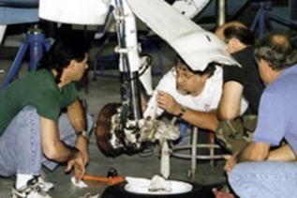
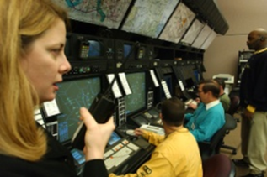
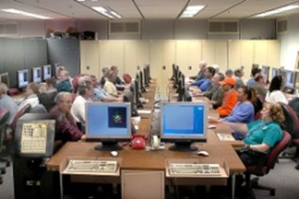
Technical Center: Multiple FAA Missions
Modeling and Simulation
Concept Development and Validation
Systems Engineering
Research &
Development
Test and Evaluation
ACY Tower (ACM)
Engineering/Program Management
Laboratories
Center Operations
Flight Inspections
Operations Support
Safety
Notes:
The capabilities at the TC directly support and follow the development and maintenance lifecycle for the National Airspace System and NextGen.
At the Center research work and concept development and validation occurs. This is done sometimes through prototyping and sometimes through extensive modeling and simulation.
These results are then integrated into FAA’s plans through system engineering and are eventually developed into products/systems through our resident engineering/program management functions at the Center.
All of these activities have extensive involvement from our operational users including pilots, air traffic controllers and air traffic system specialists.
Also at the Center we have ongoing operational support, safety, and inspection responsibilities which are used to insure the safe and efficient operation of the current NAS
And these activities - new products/systems, upgrades, and fixes are developed, integrated and tested in our laboratory environment and supported by Center Operations
With the results being ultimately deployed to operational facilities such as our tower at the Atlantic City airport

Slide 7
Estimated Economic Impact
Impact | Southern New Jersey
Total Output | $678 Million/yr.
Labor Income | $449.3 Million
Employment | 7,761 Full Time Jobs
Note: Data from DOT/FAA/TC-TN-TN15/45 - Economic Impact of the William J. Hughes Technical Center of Southern New Jersey: Update 2015
7
7

Slide 8


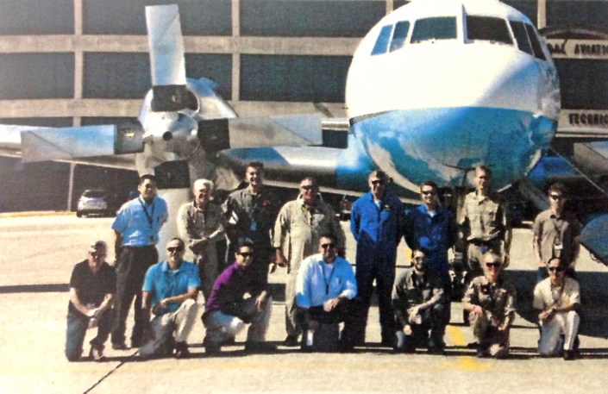



William J. Hughes Technical Center
Technical Center’s Global Aviation Impact
MIT and TC Flight Program
Industry
Academia
International
Government
Notes:
The Center’s mission includes being the 'fusion' location for all things NAS in the time span of yesterday, today and tomorrow.
The primary purpose is to make dreams (concepts) into a reality and sustain them at peak operating efficiency.
To do this requires high levels of collaboration with Industry, Academia, Government, and International.
Industry partners: Air Traffic Control Association, Boeing, Computer Sciences Corporation, General Dynamics, and many more
Academia partners: Drexel University, MIT, Ohio University, Penn State, Stevens Institute of Technology
Government partners: Department of Homeland Security, NASA, US Air Force Research Lab, EUROCONTROL
International partners: International Conference on Research in Air Transportation, International agreements – Canada, Netherlands, France and United Kingdom

