Slide 1
Airborne Contagion Assessment
Ventilation Alarms System
Business Development Presentation
Walt Sobkiw
March 2023

Slide 2
Elevator Pitch (1 minute)
We had a terrible pandemic where 1+ million people died in the US alone
The country was shutdown for 2+ years
Trillions of dollars spent on preventing the civilization from collapsing
COVID-19 Systems research shows that we have massive problems with our building ventilation systems
Started with energy crisis in 1970s continued when cigarettes were banned and is getting worse with desire to reduce carbon footprints
Research shows Vaccines alone will not solve the problem, We must fix our ventilation systems
We reject government regulation, existing companies are ignoring the problem
Solution is room ventilation alarms that alert occupants to ventilation issues like smoke detectors alert occupants to fire hazards
Vents and grills measure ventilation at the room level and generate alarms
Room & building panels show ventilation rates and generate alarms
Anyone can check the ventilation in a room they visit using their smartphones
The market is massive because it is infrastructure - $$$ Billions
We have software, a database with 1000+ buildings, 20+ million square feet, 25,000+ rooms, patent application, business plan
To duplicate this work could take 2+ years and cost $6+ million
We are looking for licensees and or partners to manufacture and distribute this system
www.cassbeth.com

Slide 3
Backup Slides
Introduction, Need, Facility Findings, Solution

Slide 4
Introductions
Performed COVID-19 research from a systems perspective
Research was about determining probability of infection using common operational living scenarios
Changed the dialogue to admit that the COVID-19 virus is airborne, and that ventilation is critical
Wrote a book: COVID-19 A Systems Perspective
Research showed:
Massive problems with our Building Ventilation systems

Slide 5
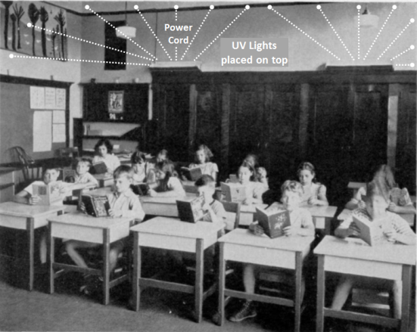
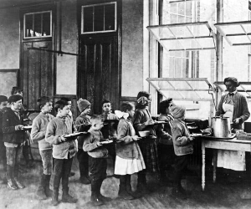
Our Parents & Grandparents Gave Us Modern HVAC & Other Ventilation Systems
Swarthmore Public School Classroom
circa 1937 - 1943
Open windows Public School cafeteria circa 1908
Captured years of data to determine effectiveness of UV to deal with airborne contagions.
Determined that this was a very effective approach to deal with airborne contagions.
These systems rolled out through the decades, we found them in many facilities during 50s 60s and the 70s.
UPENN study with Ceiling Level UV lights.
First US fresh-air school for tubercular children opened in Providence in 1908 and by 1910 there were 65 fresh-air schools in the country.

Slide 6
What Happened
We became very healthy
We turned down our ventilation systems
Starting with 1970’s energy crisis
Continued with banning of cigarette smoke
We threw away our ceiling level UV systems (what is this)
We stopped properly maintaining & operating our systems (who cares)
To reduce carbon footprint ventilation rates are dropping again
We lost commonsense knowledge of ventilation importance

Slide 7
Why is Ventilation Suddenly a Problem
We all grew up in a time when there was a great amount of health, and that health is attributed to modern technologies like forced air heating and cooling systems and the previous century UV systems
COVID-19 is endemic, it is like tuberculosis, measles, and other airborne contagions from the previous century
Leading cause of death for 2 years, shutdown the country, cost $trillions
To eventually eliminate tuberculosis and other airborne contagions, it took vaccines and modern forced air heat and cooling systems
Our building ventilation systems have been ignored during the time of great health when our parents and grandparents understood building ventilation

Slide 8
Facility Types Research Findings
Ventilation Performance is measured as ACH (air changes per hour)
Facility Type | ACH Levels | Maintenance | Operations
Elite Facilities | Excellent | Excellent | Excellent
Medium Facilities | Lower | Excellent | Excellent
Low End Facilities | Lower | Poor | Excellent
Low End Facilities | Lower | Excellent | Poor
Low End Facilities | None | Poor | Poor
Where does your facility fall?

Slide 9
Airborne Contagion Assessment Ventilation Alarms System
Alerts occupants to possible ventilation issues in the same way that smoke detectors alert occupants to fire hazards
New vents & grills constantly measure ventilation rates & alarm
New room and building panels show ACH levels and alarm
All connected to Internet
New market: Ventilation Alarm Systems
$$$ Billions because it is infrastructure

Slide 10
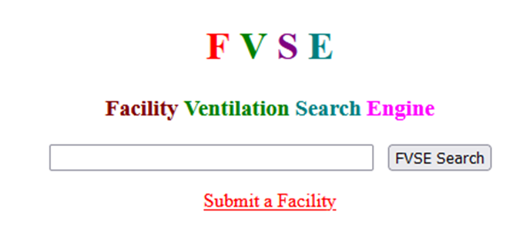
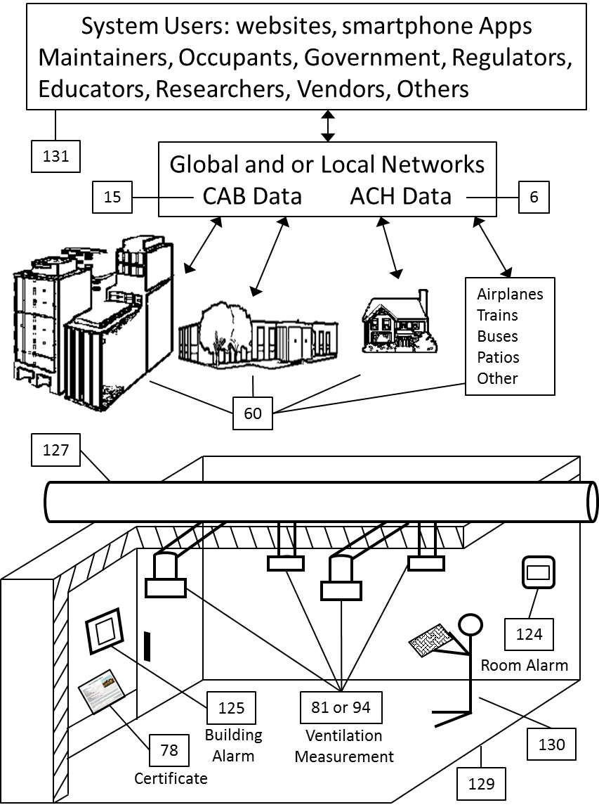
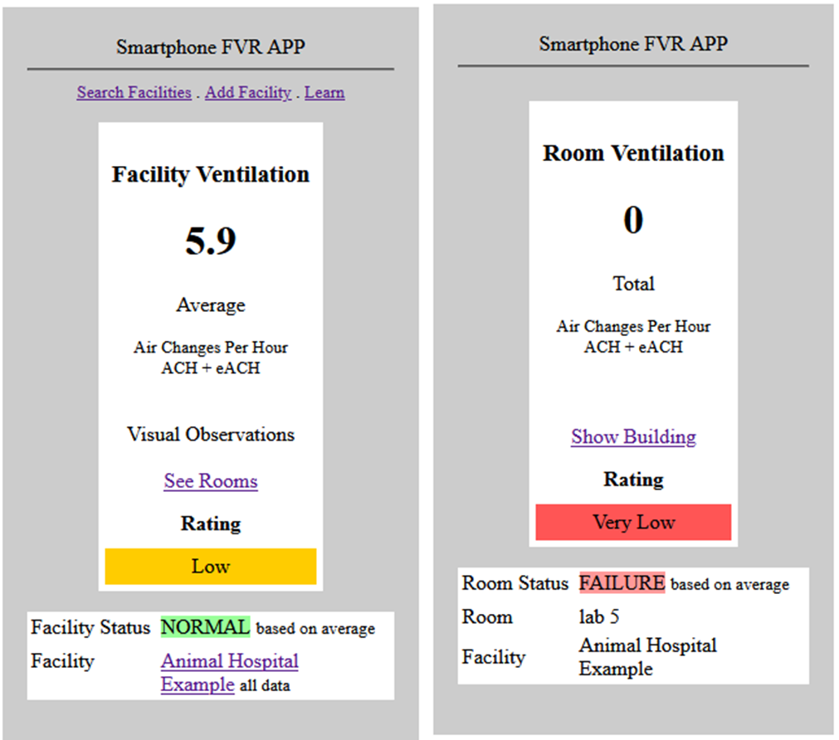
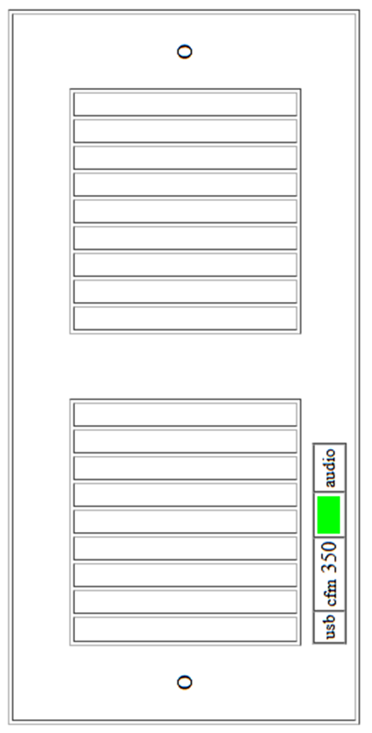
Airborne Contagion Assessment Ventilation Alarms System
User observations, Site Survey Data, Certified Government data, Future Real time Data
www.cassbeth.com

Slide 11
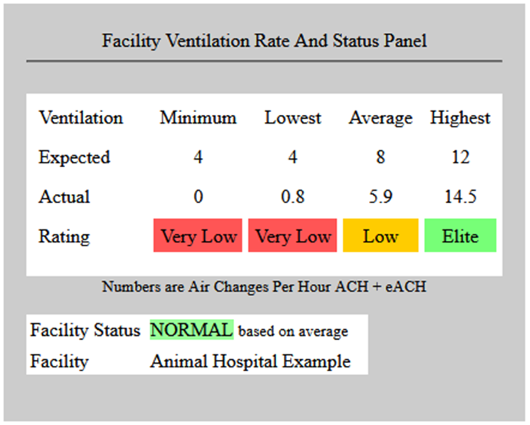
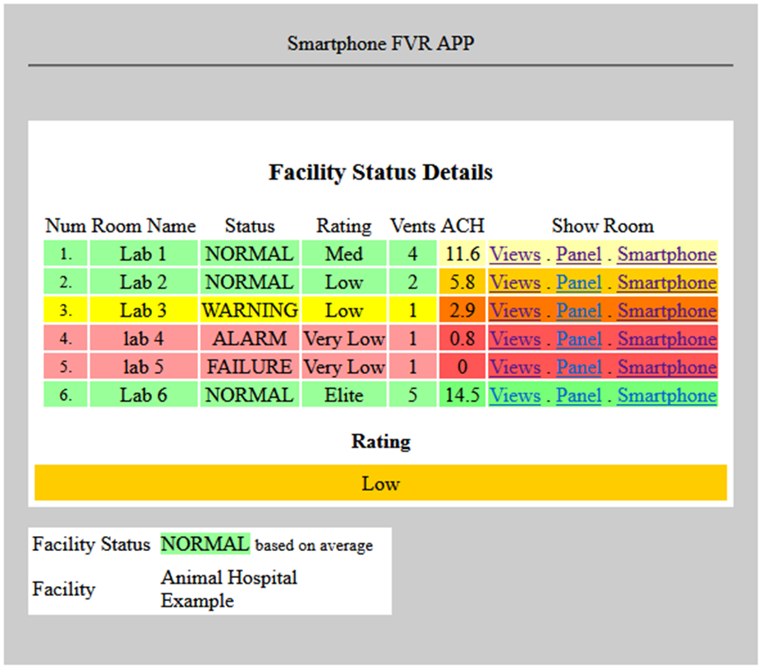
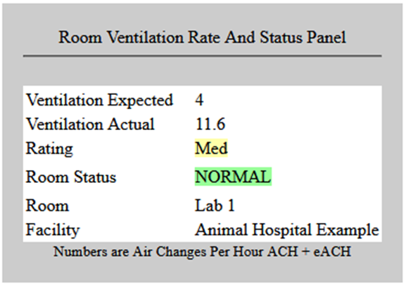
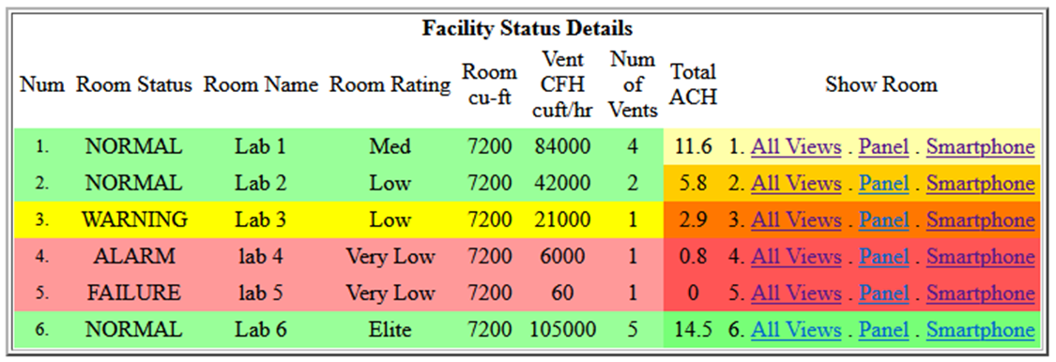
Airborne Contagion Assessment Ventilation Alarms System

Slide 12
Airborne Contagion Assessment Ventilation Alarms System
Prototype software
Database of 1000+ buildings
Patent application
Business Plan
To duplicate this work 2+ years $6+ million
Looking for licensees and or partners
to manufacture and distribute the system
New market: Ventilation Alarm Systems
$$$ Billions because it is infrastructure

Slide 13
Backup Slides
Market, Competition, Closing, Needs Statements

Slide 14
Market
Building Type | sq-ft (a)
Schools | 1,698,000,000
Commercial Office Space | 4,000,000,000
Retail | 9,500,000,000
Industrial Property | 13,000,000,000
Percent Of Market
Sales Per Year
Market Segments / Customers | Size
HVAC companies | 105,000
School districts | 16,800
K-12 schools in the U.S | 130,930
Restaurants 2018 | 660,755
Bars & Night clubs 2021 | 59,052
U.S. commercial buildings 97 2018 | 5,900,000
Brick-and-mortar retail stores 2020 | 328,208
Building Inspectors | 27,789
Veterinary Clinics | 28,000
Hardware Sales $150/1000 sq-feet
+
Hardware Licensing
IoT Annual Licensing Opportunities

Slide 15
Competition
UV companies
Sterilray, rZero
Consumer Thermostat Companies
AC Infinity, Google Nest, Ecobee, Emerson
Smart Vent Companies
EZ-FLO, Flair Smart Vents, EcoVent – KEEN
HVAC and Controls Companies
Honeywell, Traine, Carrier, Lennox, Siemens, Johnson Controls
Air Flow Sensor Companies (industrial)
Proteus, Degree Controls Inc., FLW Inc., National Control Devices
Wi-Fi Bluetooth USB Anemometer Brands
AIOMEST, Protmex, BTMETER, Holdpeak, Netatmo
There is no one in this market
Existing companies are potential partners and or licensees
International Competition is the Threat
It is not If but When
Time is of the Essence

Slide 16
Closing Comments
In the last century, our parents and grandparents had to deal with tuberculosis and other deadly infections
Vaccines did a great deal to eliminate those contagions, but they would not have worked without the introduction of forced air HVAC systems and ceiling level UV systems
Unlike in the last century no new technology is needed, we just need to use what our parents and grandparents developed
There always will be unvaccinated people
The system solution must use vaccines + ventilation
The analysis clearly shows why; large numbers of people will continue to get sick and die – see this research findings

Slide 17
Professor Edward A. Nardell Harvard Medical School
From Time Magazine February 1, 2022: If We're Going to Live With COVID-19, It's Time to Clean Our Indoor Air Properly, Edward A. Nardell is Professor of Global Health and Social Medicine, Harvard Medical School.
COVID-variants may be with us for years to come, and this will certainly not be the last respiratory virus pandemic. We have long suffered from annual contagious respiratory infections, but exceptionally low rates of influenza and common colds during COVID-precautions have demonstrated that not all of this suffering need happen. So, we need to think clearly and scientifically about how better we can reduce the spread of viruses indoors especially when and where masks will no longer be in common use.
Are there effective engineering controls that can help make indoor environments truly safer?

Slide 18
A Paradigm Shift to Combat Indoor Respiratory Infection
In May of 2021, 39 scientists published "A Paradigm Shift to Combat Indoor Respiratory Infection"
There is great disparity in the way we think about and address different sources of environmental infection.
Governments have for decades promulgated a large amount of legislation and invested heavily in food safety, sanitation, and drinking water for public health purposes.
By contrast, airborne pathogens and respiratory infections, whether seasonal influenza or COVID-19, are addressed weakly, if at all, in terms of regulations, standards, and building design and operation, pertaining to the air we breathe.

Slide 19
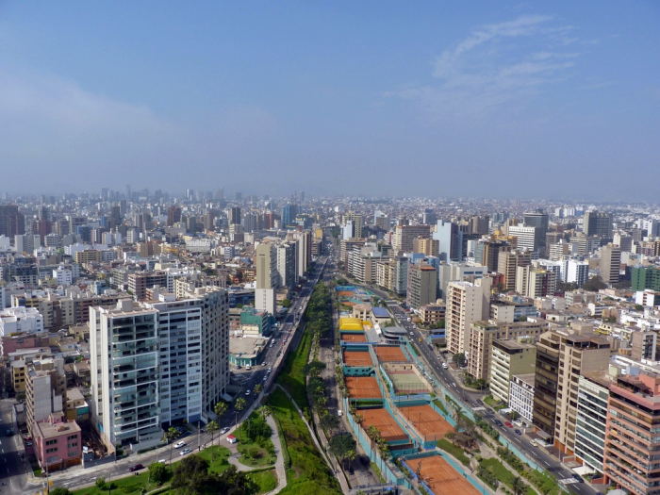
Peru
June 2022
Peru
640 deaths per 100,000 people
World is 80, US is 304
Building Ventilation is about all buildings everywhere…
Lima Peru
https://en.wikipedia.org/wiki/COVID-19_pandemic_by_country_and_territory

