Slide 1
HIT Policy Update
COVID-19 Edition
John D. Halamka MD
March 26, 2020

Slide 2
Waiver of HIPAA Sanctions
The requirements to obtain a patient's agreement to speak with family members or friends involved in the patient’s care. See 45 CFR 164.510(b).
The requirement to honor a request to opt out of the facility directory. See 45 CFR 164.510(a).
The requirement to distribute a notice of privacy practices. See 45 CFR 164.520.
The patient's right to request privacy restrictions. See 45 CFR 164.522(a).
The patient's right to request confidential communications. See 45 CFR 164.522(b).

Slide 3
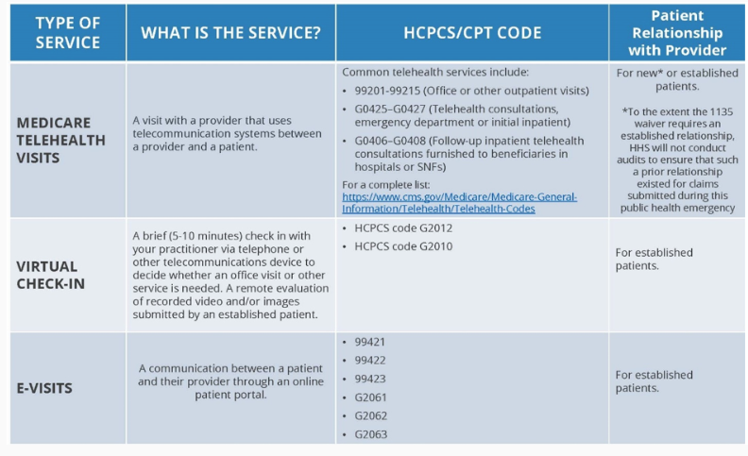
Expansion of Telehealth

Slide 4
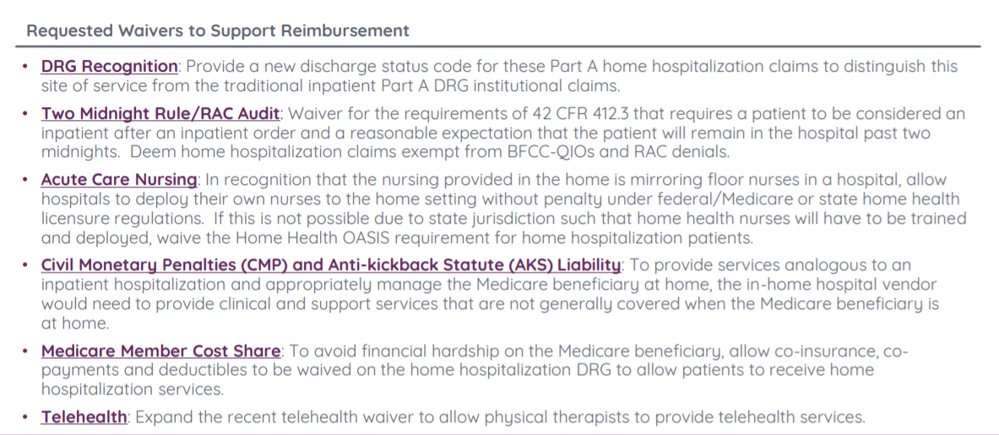
Virtual Hospital

Slide 5
Purpose of the Final Rule
Patients: Right of Access to their Chart, Supporting Patient Privacy and Security, the Ability to Shop for Care and Avoid Bankruptcy
Doctors and Hospitals: Making Patient’s Chart Data Requests Easy and Inexpensive, Allowing Choice of Software, Implementation
Patients, Doctors, and Hospitals: Improving Patient Safety
Health IT Developers: Minimizing API Development and Maintenance Costs, Protecting Intellectual Property
American Public: Maximizing Innovation, Transparency in Health Care

Slide 6
Conditions and Maintenance of Certification Requirements
Conditions of Certification with Maintenance of Certification Requirements
Information Blocking
Assurances
Communications
Application Programming Interfaces (APIs)
Real World Testing
Attestations
The 21st Century Cures Act requires HHS to establish Conditions and Maintenance of Certification requirements for the ONC Health IT Certification Program.

Slide 7
4. Application Programming Interfaces (APIs)
ONC has established API Conditions of Certification to address the use of certified API technology (Section 170.315 g7-10) and the healthcare ecosystem in which certified API technology will be deployed, including health IT developers’ business practice.
Key Definitions
Certified API Technology Capabilities of health IT that fulfill any of the API-focused certification criteria adopted in the rule
Certified API Developer Health IT developer that creates the “certified API technology”
API Information Source Organization that deploys certified API technology
API User Persons and entities that create or use software applications that interact with “certified API technology”
SCOPE OF ELECTRONIC HEALTH INFORMATION
The scope of patients’ electronic health information that must be accessible via certified API technology is limited to the data specified in the United States Core Data for Interoperability standard (USCDI).

Slide 8
Information Blocking
What is information blocking?
A practice by a health care provider, health IT developer, health information exchange, or health information network that, except as required by law or specified by the Secretary as a reasonable and necessary activity, is likely to interfere with, prevent, or materially discourage access, exchange, or use of electronic health information.
What are the exceptions?
Section 4004 of the Cures Act authorizes the Secretary to identify reasonable and necessary activities that do not constitute information blocking.
In consultation with stakeholders, we have identified eight exceptions for practices that are reasonable and necessary, provided certain conditions are met.
Three categories of "Actors":
Health Care Providers
Health IT Developers of Certified Health IT
Health Information Exchanges and/or Health Information Networks

Slide 9
Information Blocking Exceptions
Exceptions that involve not fulfilling requests to access, exchange, or use EHI
Preventing Harm Exception
Privacy Exception
Security Exception
Infeasibility Exception
Health IT Performance Exception
Exceptions that involve procedures for fulfilling requests to access, exchange, or use EHI
Content and Manner Exception
Fees Exception
Licensing Exception

Slide 10
Questions?
http://geekdoctor.blogspot.com
@jhalamka on Twitter

